Slide 1

Bioinformatics Bootcamp
Biomedical Machine Learning with Python
PART II: Machine Learning for Biomedical Applications
Module 11: Image Processing

Slide 2
Contact Info
Daniel Montemayor Ph.D.
Assistant Professor / Research
Center for Renal Precision Medicine
Department of Medicine
UT Health San Antonio
Email: montemayord2@uthscsa.edu
Office hours: https://calendly.com/daniel_montemayor/montemayor-office-hours

Slide 3
Part II : Overview
Getting to know your data
Formatting | Visualization | Partitioning | Normalization | Integrity
Feature Selection
Parsimony | Dimension Reduction | Supervised and Unsupervised Methods
Classification Models
Cross-Entropy and other Error Metrics | Random Forest | Logistic Regression
Regression Models
Linear Regression | Regularization | LASSO | Elastic-Net
End-to-End ML Workflow – Leukemia Project (two weeks)
Image Processing - Convolutional Neural Networks
Adv. Topics – Unet |Res net | Recurr net | Attention net

Slide 4
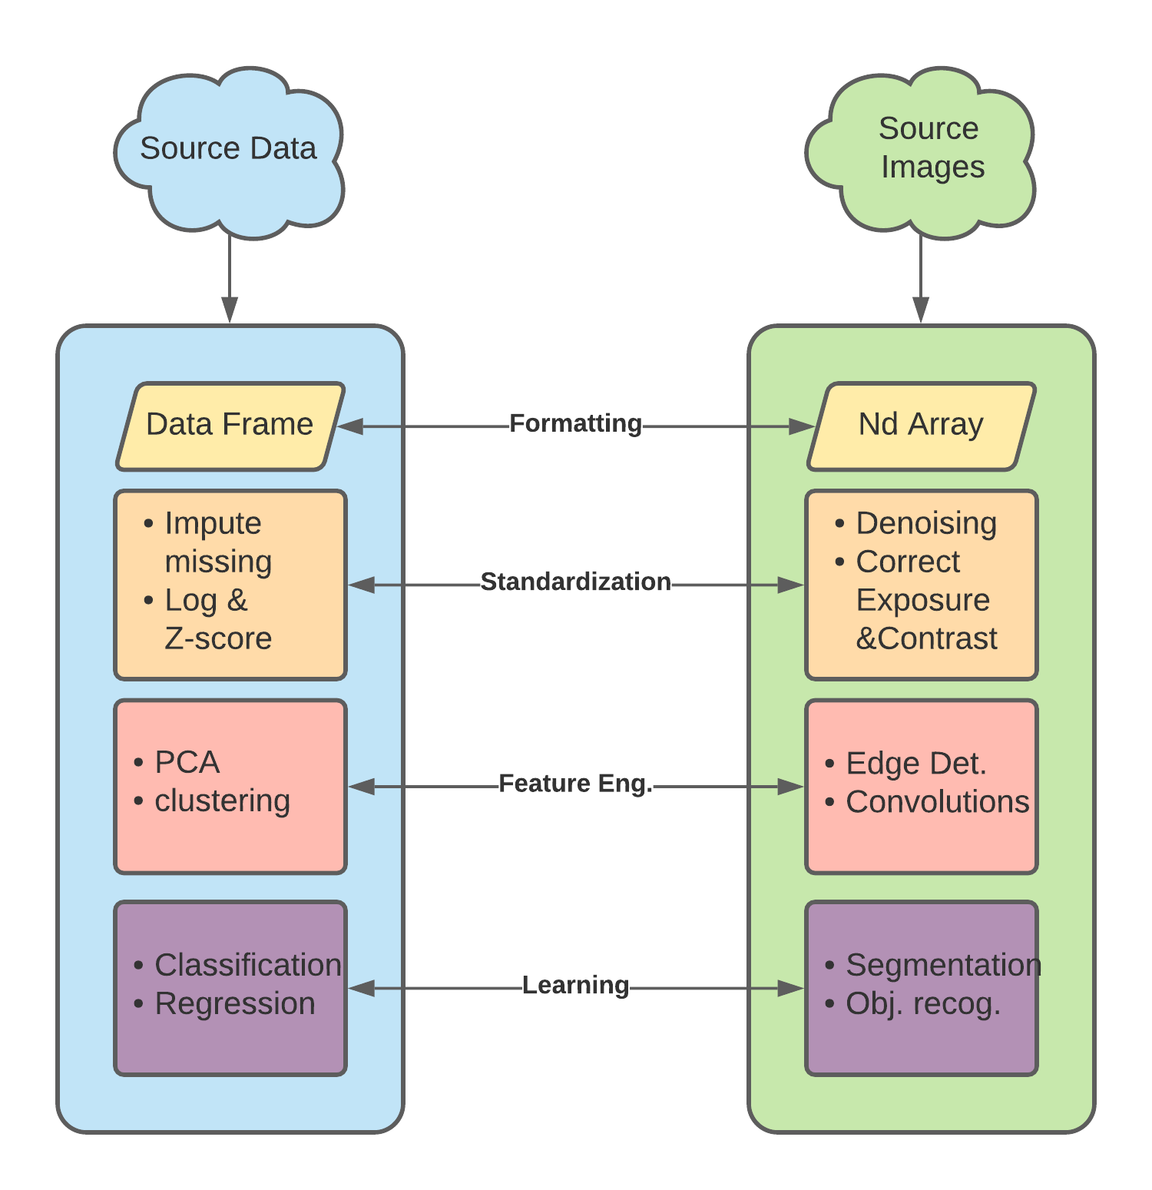
What is Image Processing
Preparing images for use in ML workflows
Analogous to Data Processing
History since before ML was mainstream. Analytical methods implemented Scikit image.
Can prepare images for deep-learning (ie Convolutional Networks) or classic ML (like RF or linear models).

Slide 5
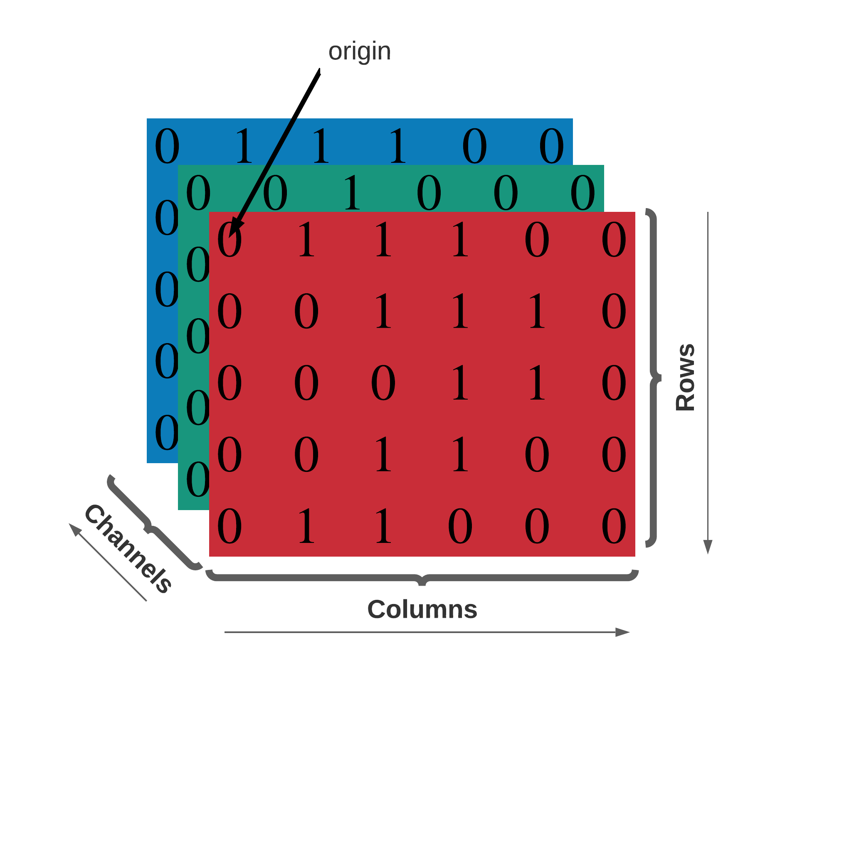
Formatting
Scikit-image uses NumPy to represent images as ndarrays
2D grayscale: [row, col]
2D multichannel: [row, col, chan]
3D grayscale: [plane, row, col]
3D multichan: [plane, row, col, chan]
Developing convention for time
2D grayscale video: [t, row, col]
3D multichan video: [t, pln, row, col, ch]
Note cartesian convention (x, y, z) translates to [col, row, plane]

Slide 6
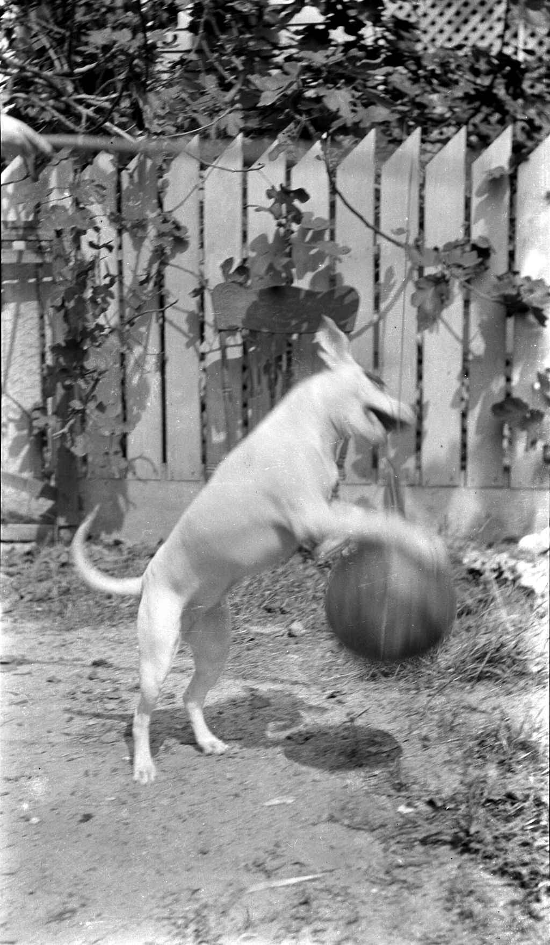
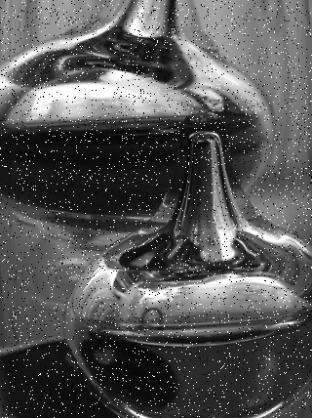
Denoising
Refers to removing spurious image artifacts due to:
Hardware limits of detection
Motion blur & artificial lensing
Image compression & transmission errors
Noise generally falls into two categories
Salt and Pepper – Impulse noise
Blur – Convolutional noise
Salt and pepper
Source wikicommons
Blur
Source wikicommons

Slide 7
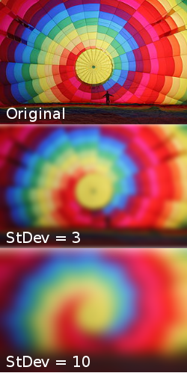
Denoising
Examples of Gaussian Blurring
Convolution Filter
Sum of the product over a window of pixels
Think running average
Usually blurs image due to averaging
Source wikicommons
Source wikicommons
Notes:
channels

Slide 8
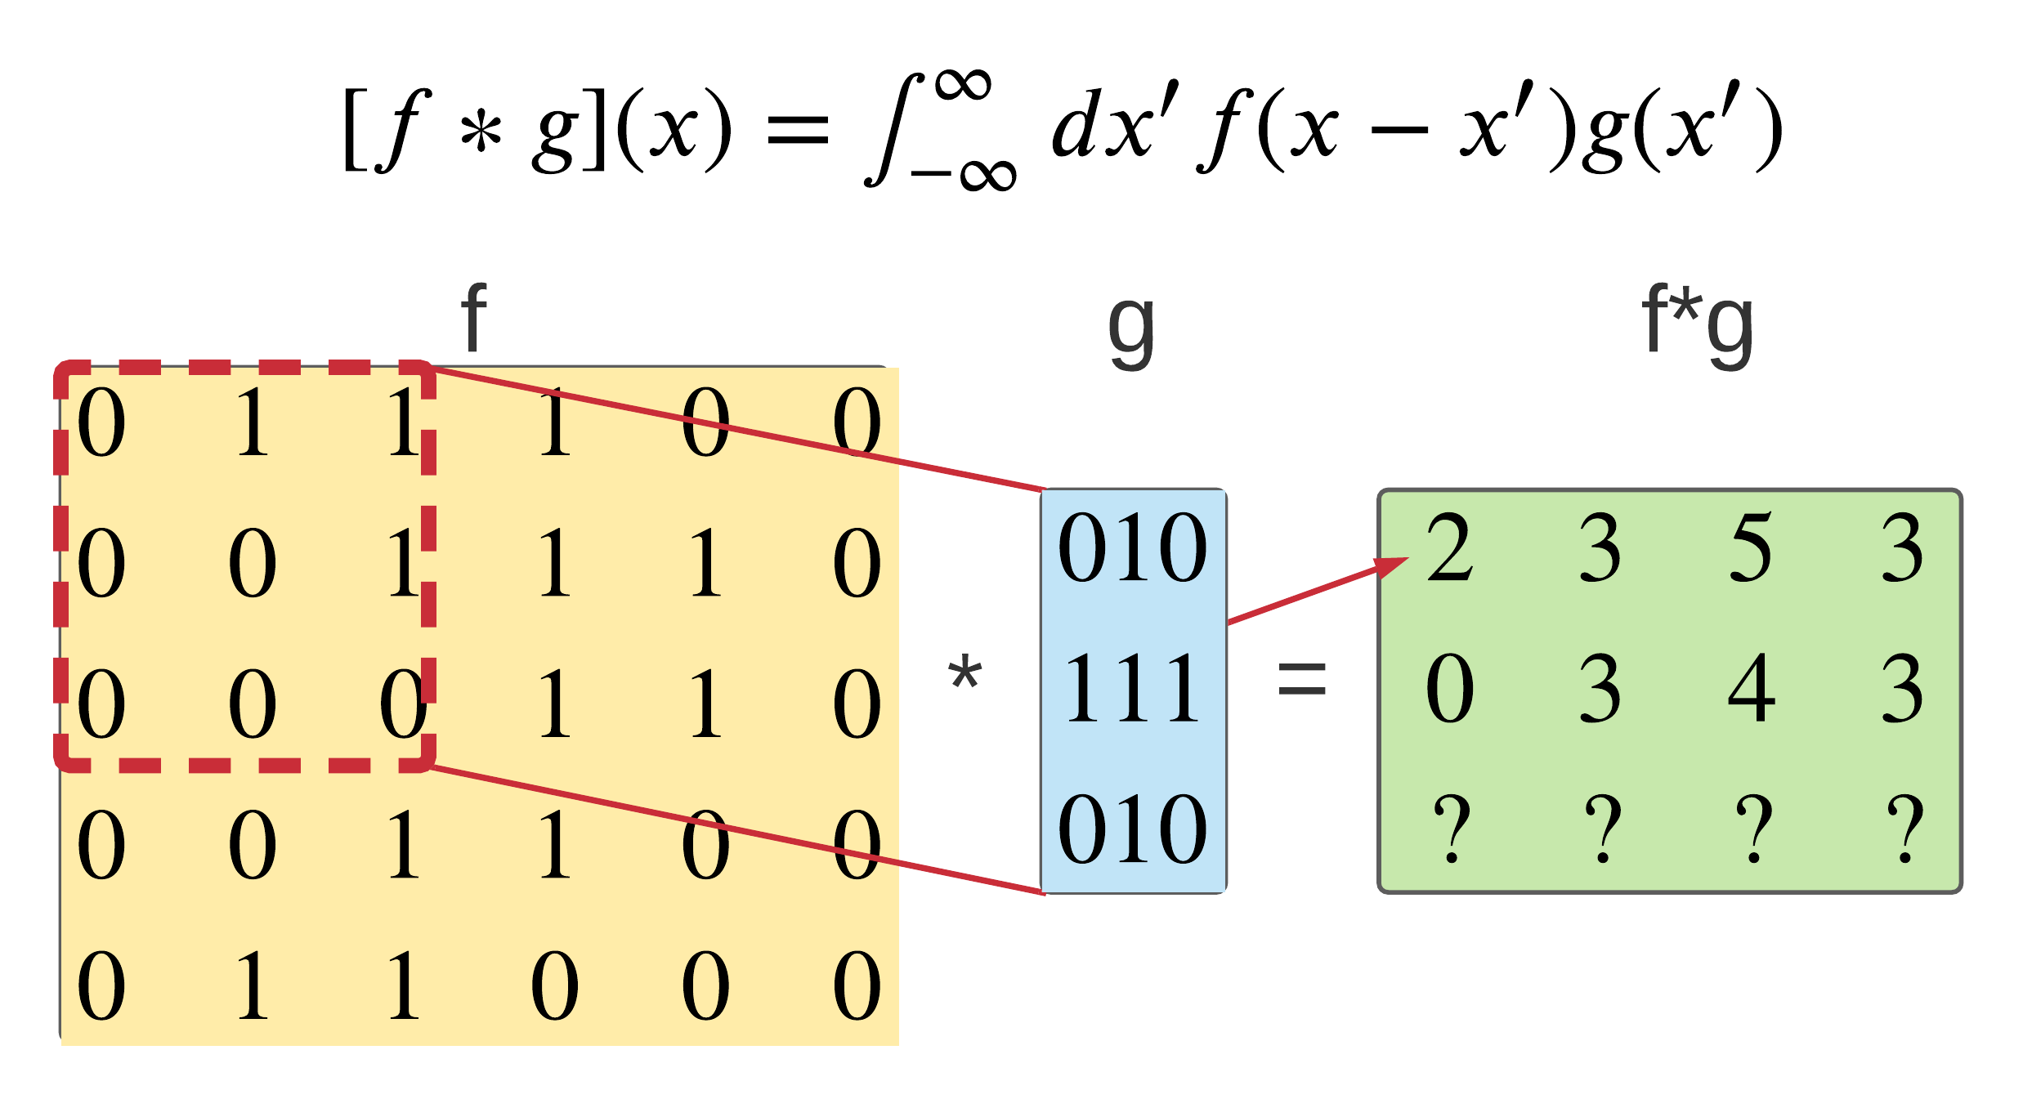
Denoising
Convolution
Convolution Filter
Sum of the product over a window of pixels
Think running average
Usually blurs image due to averaging

Slide 9
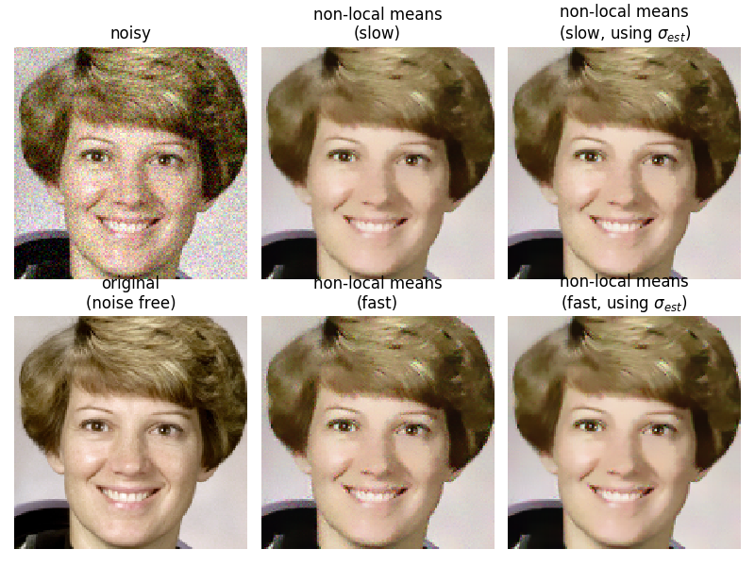
Denoising
Non-local Means Filter
Replaces the value of a pixel by the average of small nearby patches.
Can restore textures blurred by simple convolution.

Slide 10
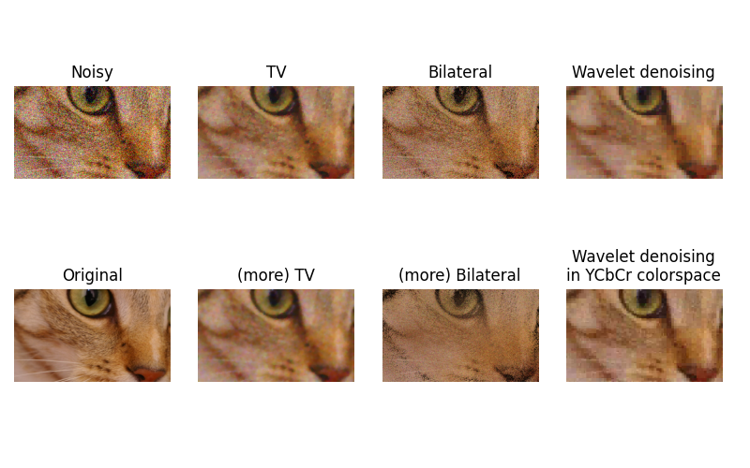
Denoising
Other popular methods
Total Variation Filter
Minimize L1 norm of the image gradient.
Bilateral Filter
Averages pixels based on their spatial closeness and similarity. Good edge preservation.
Wavelet
Denoising in the Fourier domain – think lowpass filter
Example of denoising by total variation, bilateral filter, and wavelet method. Source: skimage denoising tutorial

Slide 11
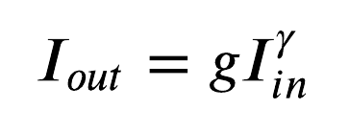
Exposure
Input should have same range of values
Gamma correction
Humans perceive “brightness” on log scale
Power law transform for image values 0-1
Source wikicommons

Slide 12
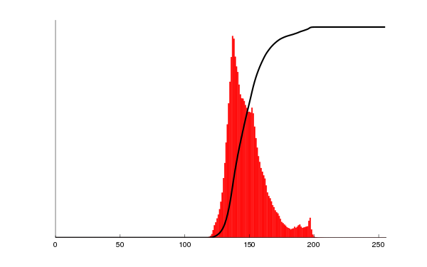
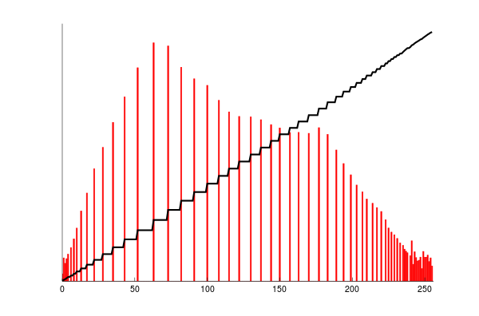
Exposure
Histogram
Contrast Limited Adaptive Histogram Equalization (CLAHE)
Applies to grayscale images
Compares histograms in different tile regions of the image. Enhances Local details even in regions that are darker or lighter than most of the image.
Original image
Histogram
Source wikicommons
Histogram EQ image

Slide 13
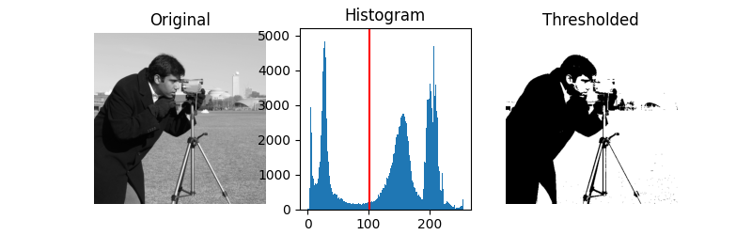
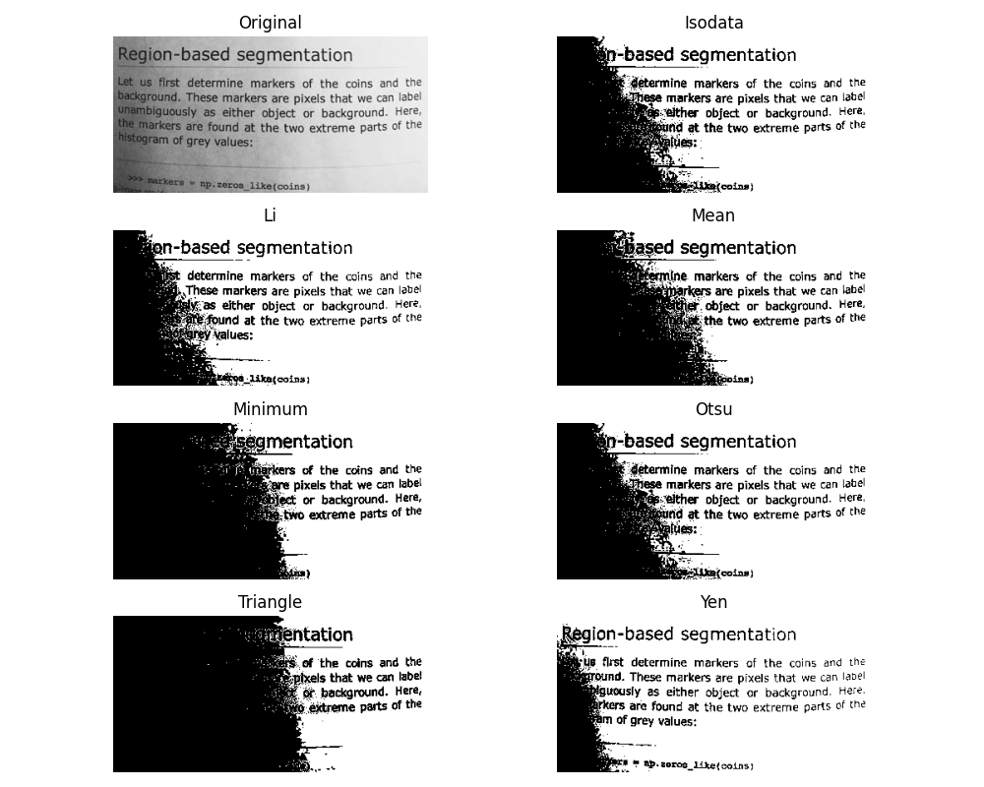
Segmentation
Histogram Based Thresholding
Binarize an image using a histogram cutoff
Think binary classification
Otsu’s method is very popular –like K-means it seeks to minimize intra-class variation while maxing inter-class variation of the two clusters.
Scikit-image includes a function skimgae.filters.try_all_threshold to evaluate thresholding algorithms provided by the library. At a glance, you can select the best algorithm for your data.
Notes:
-future resources – books. Digitalsereeni,

Slide 14
Segmentation
Superpixels
Extend thresholding to multiple clusters
Find clusters i.e. “super-pixels” using clustering method like K-means.
Not limited to grayscale.
Simple linear iterative clustering (SLIC) is popular method
Source EPFL Labs
Notes:
-future resources – books. Digitalsereeni,

Slide 15
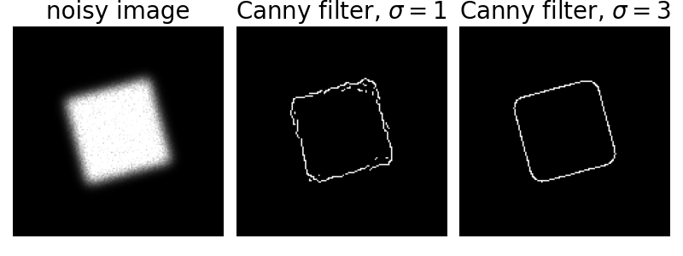
Feature Detection
Edge detection
Canny edge is most popular method
Gaussian based method where sigma defines window size
Notes:
-future resources – books. Digitalsereeni,

Slide 16
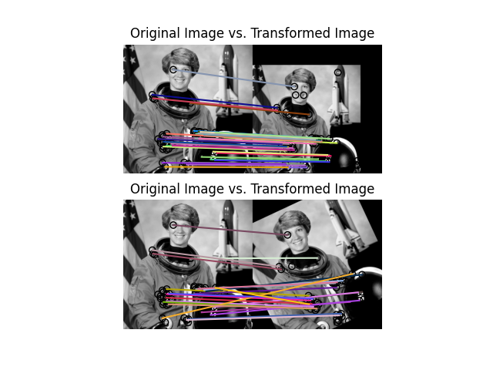
Feature Detection
Corner detection
Where edges meet
Corners are where the interesting stuff (useful information) is
Corners are useful for image registration
MANY corner detectors available on scikit-image
Image Registration – find corresponding landmarks between images and use them to define how one image can be warped to align with the 2nd.
Notes:
-future resources – books. Digitalsereeni,

Slide 17
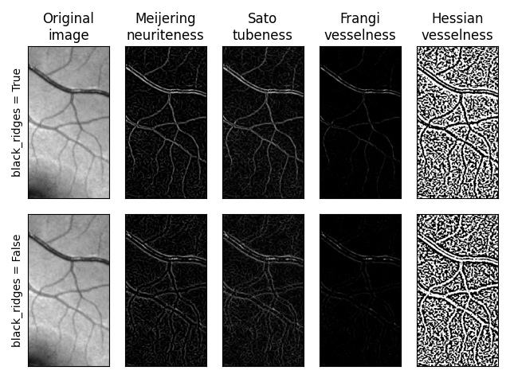
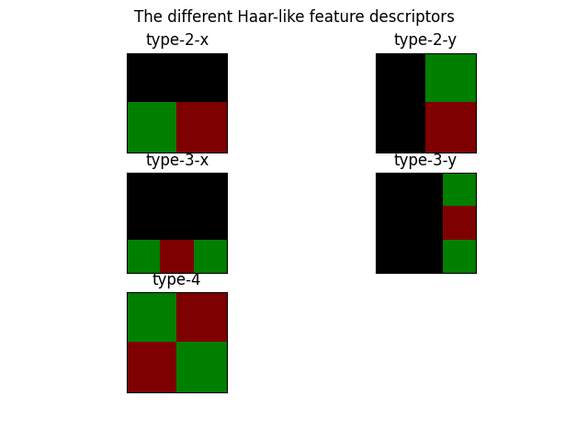
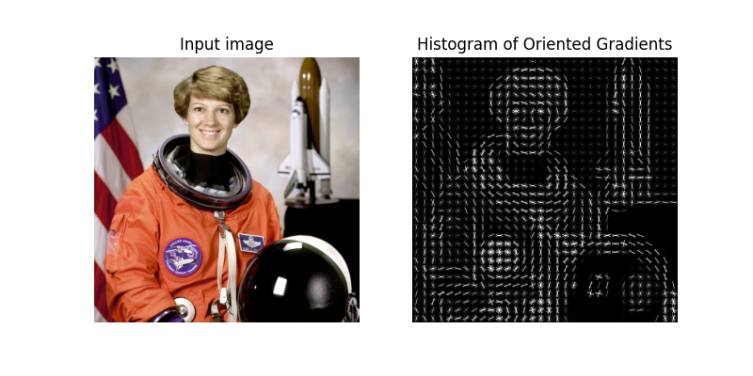
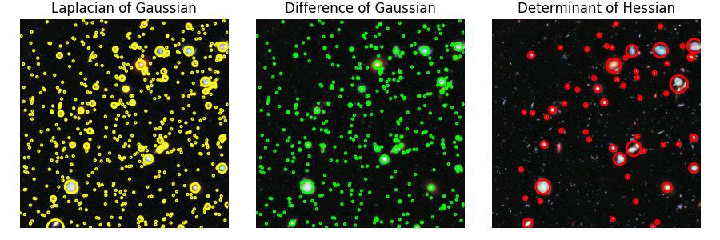
Feature Detection
Ridges
Haars
Other Features in skimage.feature module
Ridges
Straight lines/elipses
Blobs
Hogs
Daisies
Haars
Or create your own!
Blobs
HOGs
Notes:
-future resources – books. Digitalsereeni,

Slide 18
Segmentation Recap
Histogram based Segmentation
Use image intensity to classify
Semantic Segmentation
Use calculated pixel features to assign a class to each pixel.
Image Classification
Learn useful features automatically to do classification
Notes:
-future resources – books. Digitalsereeni,

Slide 19
Convolutional Nets
Quantify useful features in image to do classification.
Major features
Convolutional layers
Pooling layers
Fully connected layers

Slide 20
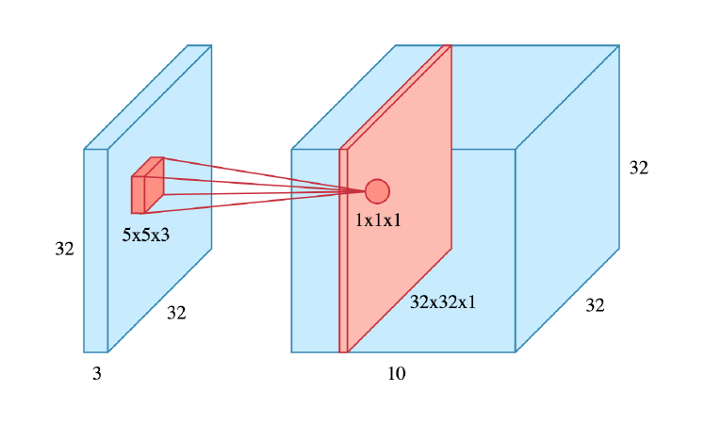
Convolutional Nets
Color Image
Convolutional Layers
Learn 10 (5x5) convolutions

Slide 21
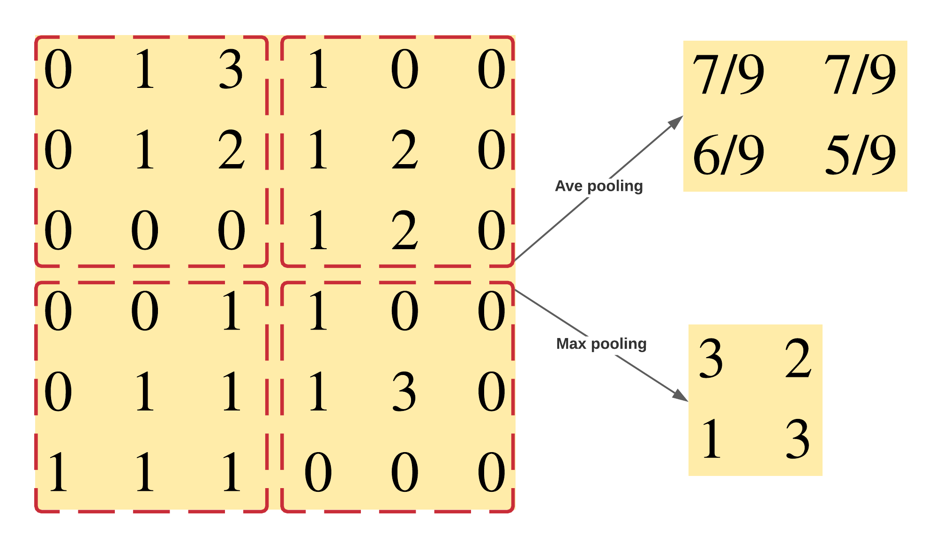
Convolutional Nets
Pooling Layers
Ave pooling can do dimension reduction
Max pooling can also do denoising

Slide 22
Convolutional Nets
Example CNN model for classifying MNIST handwritten digit dataset

